Slide 1
Software Process Framework
Framework is a Standard way to build and deploy applications.
Software Process Framework is the foundation of complete software engineering process.
Software process framework includes set of all umbrella activities.
It also includes number of framework activities that are applicable to all software projects.

Slide 2
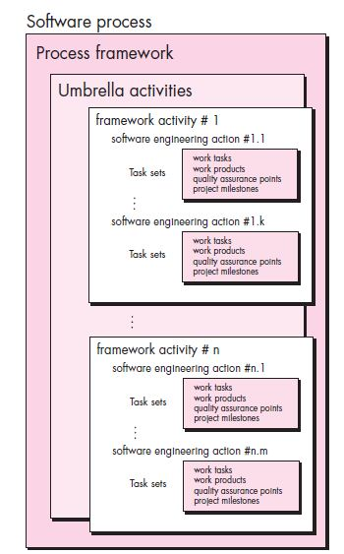
Process Framework

Slide 3
Umbrella Activities
Software project tracking and control
Risk Management
Software Quality Assurance
Technical review
Measurement
Software configuration management
Reusability management
Work product preparation and production

Slide 4
Generic Process Framework
Communication
Planning
Modeling
Construction
Deployment

Slide 5
Process Framework
Communication:
Before any technical work commence, it is important to communicate and collaborate with the customer and other stake holder.
The intent is to understand stakeholders’ objective for the project and to gather requirements that help define software and functions.

Slide 6
Process Framework
Planning
Planning helps to define the software project plan
Software Engineering plan defines the software engineering work by describing the technical tasks to be conducted, the risks that are likely, the resources that will be required, the work product to be produced, and a work schedule

Slide 7
Software Process
Modeling
By creating the models helps to better understand the software requirement and the design that will achieve those requirement.

Slide 8
Software Process
Construction
This activity combines code generation and the testing that is required to uncover errors in the code.

Slide 9
Software Process
Deployment
The software is delivered to the customer who evaluates the delivered product and provides feedback based on the evaluation.

